Slide 1
Bash basics

Slide 2
Filesystem Structure
0
Know it like the back of your hand :)

Slide 3

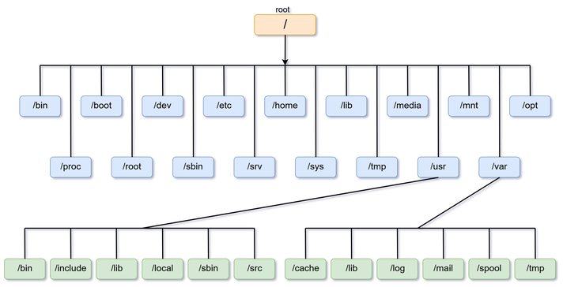

Slide 4
Directories
/bin /usr/bin
Common executable programs & commands
/usr/sbin
Also holds commands but only admin user specific commands
/home
User home directories
Each user has its own directory
/lib
Shared libraries and kernel modules necessary to boot the system
/proc
Virtual filesystem documenting kernel and process status as text files
/boot
Stores startup files and kernel

Slide 5
Directories
/etc
Configuration files for your system and services
/opt
Optional
Contains extra and third-party software
/var
Variable
Stores files that the system writes and reads data from during operation
/dev
Devices
Stores files that represent the physical parts of the computer
/mnt
Mount
Used for temporarily mounting things
/media
Accessing removable media

Slide 6
File components
Everything in linux is a file, including directories (we’ll explain later)
What defines a file?
Name
Contents
Administrative information
Stored in the inode
Inodes r wack… we’ll come back to them later

Slide 7
Review Basic Cmds
1
Let’s start with the basics!

Slide 8
Basic Cmd Navigation
pwd
Print working directory
ls
Listing files
cd
Change directory
Absolute Paths vs Relative Paths

Slide 9
File Manipulation
touch [FILE]
Opens and closes a file
cp [SOURCE] [DESTINATION]
mv [SOURCE] [DESTINATION]
Renaming tool
rm [FILE]
remove

Slide 10
Directories
mkdir [DIRECTORY]
rmdir [DIRECTORY]
Only works if dir is empty

Slide 11
File Editing
gedit [FILE]
Common graphical editor
nano [FILE]
Terminal editor

Slide 12
File viewing
cat [FILE]
Outputs file to stdout
less [FILE]
Scroll thru starting at the top
Quit with q
head [FILE]
First 10 lines of file
tail [FILE]
Last 10 lines of file

Slide 13
Input & Output Streams
Standard Input
Characters you type into the terminal
Input data
Standard Output
Regular output printed to the terminal
Standard Error
Error output printed to the terminal

Slide 14
<
Redirect standard input to read from a file
>
Redirect standard output to print to a file
Overwrites file if exists
>>
Redirect standard output to print to a file
Appends to file if exists
|
Pipe operator
Redirect standard output to go to another command as standard input

Slide 15
Input & Output Streams
Standard Input
sort < [FILE]
Standard input of sort is taken from the given file
Standard Output
echo “Troy Cyber!” > testfile
Standard output redirected to “testfile”
Pipe Operator
grep -R “Cyber” testfile | wc -l
Count the occurrences of “Cyber” in the file “testfile”
Output from the left becomes input into the right

Slide 16
General Unix Tools
2
Familiarize yourself with these!

Slide 17
Comparing Files
diff [FILE1] [FILE2]
> indicates the line is in file2, but not file 1
< indicates the line is in file1, but not file2

Slide 18
Downloading files
wget [URL]
Will retrieve whatever file is stored at that url

Slide 19
Extracting files
.tar.gz files:
tar xzvf [FILE.tar.gz]
.zip file:
unzip [FILE.zip]

Slide 20
Searching
find
Recursively searches based on certain criteria
locate
uses an indexed database
must use updatedb first
grep
pattern matching throughout text (we’ll learn how to use regex much later)

Slide 21
Misc. useful cmds (good for forensics!)
wc [FILE]
Word count
wc -l /etc/passwd
Number of users in the passwd file
cut [OPTION] [FILE]
Cuts out sections and writes result to standard output
eog [IMAGE]
Image viewer
mpg123 [MP3 FILE]
Audio player
evince [FILE]
Document viewer

Slide 22
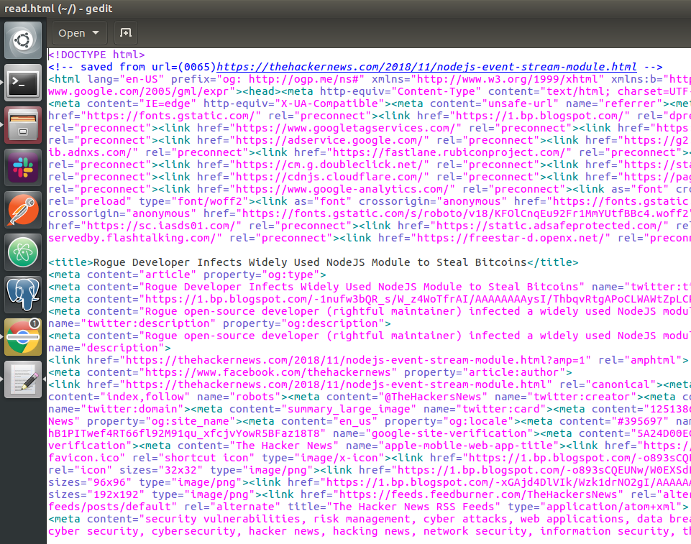
Place your screenshot here
xdg-open {FILE | URL}
Yeah you don’t need eog, evince, or mpg123 because xdg-open does it ALL
Open file or URL in preferred application
Supports ftp,file,https,http URLs
Example:
xdg-open read.html

Slide 23
Looking up any other commands
man [CMD]
Look through the built in linux manual
whatis [CMD]
very brief description
Online man pages
Manuals but now with colors and ctrl f functionality :D

Slide 24
Shell Stuff
3

Slide 25
Bash
Bourne-again shell
This is the shell you use by default in linux
Can be accessed with the bash cmd
You can use other shells such as sh if you want
Not recommended
Bash is a language, cmds are just part of the it

Slide 26
Shell Metacharacters
$ | Shell Variable
~ | Special home directory variable
& | Background command execution
; | Command termination
* ? [ ] | Shell wildcards
‘ ‘’ \ | Metacharacter quotes
Special Characters used to represent something
Redirection symbols we talked about earlier
Wildcard substitutions
Escape characters

Slide 27
Examples
cd ~
will take you to your user’s home directory
apt upgrade &
will upgrade in the background
apt update; apt upgrade
will run apt update. ; signifies that the command has ended, and then linux will move on to the next one: apt upgrade
ls *.txt
ls -l file[1-3]
will list out file1, file2, and file3
ls -l file?
will list out anything starting w file and having 1 extra character afterwards
ls file\ 1
will list a file called “file 1”. the \[space] is the escape character

Slide 28
Shell Metacharacters con't
&& | and operator
|| | or operator
! | not operator
!! | previous cmd
{} | create range
Notes:
!! ex: sudo !! will do prev cmd but w sudo perms
{} ex: echo {0..10} will print out 0 to 10

Slide 29
Examples
Ex: apt update && apt upgrade -y
Will execute apt update. If that works, move onto apt upgrade -y. If that works, return true
If EITHER of those don’t work, return false
Ex: apt-update || apt upgrade
Will execute apt update and then apt upgrade. If either works, then return true
If BOTH don’t work, then return false
! is used more for bash scripting, we’ll get there eventually
sudo !! means run prev cmd as sudo
touch {a..z} creates files a-z

Slide 30
Shell Variables
2 types
Local & environment
env or printenv
List of all environmental variables
External command → runs in child process
set
Display ALL the variables available in the current shell
Built-in command
Notes:
Env is an external command and runs in a child process. It thus displays only those variables that are inherited from its parent, the shell.

Slide 31
Environmental Variables
Defined for current shell & inherited by any child shells or processes
echo $LOGNAME
Display username
echo $HOME
Current user’s home directory
echo $PATH
List of directories to search for executable files when the user runs a command
Notes:
Environmental variables control the behavior of the system. The determine the environment in which we work.

Slide 32
Path variable
Ex: /home/joseph/.local/bin:/usr/local/sbin:/usr/local/bin:/usr/sbin:/usr/bin:/sbin:/bin:/usr/games:/usr/local/games
When I use ls, the system checks $PATH and asks, “is ls in any of these directories?”
Happens to be in /bin/ls
So the system will do /bin/ls
Otherwise, the system will check within your current directory for an executable called ls
If you wanted to, you could just use /bin/ls directly

Slide 33
Files in depth : inodes
4

Slide 34
What is in an inode?
Contains administrative info/system data
Mode/permission (protection)
Owner ID
Group ID
Size of file
Number of hard links to the file (we’ll get to this later)
Disk block location of file contents
Time FILE last accessed
Time FILE last modified
Time INODE last modified
Does NOT contain the FILENAME
That’s stored in the file’s PARENT directory

Slide 35
Why bother understanding inodes?
Directory hierarchy is just a convenient way to NAME the files
The system’s internal name for a file is the i-number
I-number: Number of the inode holding the file’s info
Basically, from the i-number, the kernel can access inode contents (including location of the file) and THEN it can access the file
View i-number with ls -i
Could be potentially tested as a forensics question
Are one of the foundational elements of the linux FS
Responsible for hardlinks in linux

Slide 36
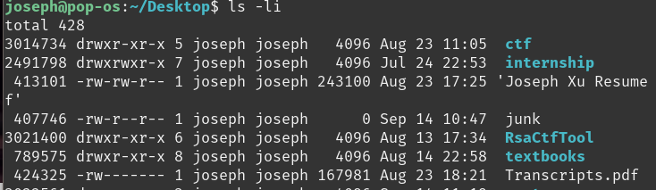
Example
Number on the very left is the inode-number
This is how the system refers to files in linux

Slide 37
So what’s in a directory?
Directories are just files that contain special tables
Contain filenames within the directory and their corresponding inode numbers
So a filename in a directory is called a LINK because it links a name in the directory to the inode
First 2 entries are always . and ..
. = inode of CURRENT directory
.. = inode of PARENT directory
Unfortunately, linux does not allow us to view the raw contents of a directory wo special tools

Slide 38
Weird implications of how directories work
Same inode can appear more than once in a directory, with 2 separate links
rm command does not remove inodes
Removes the links (directory entries)
System only removes inode when LAST link to a file disappears

Slide 39
Analogy using Java
In Java, we have objects
The content of an object is analogous to file contents
Java compiler refers to objects using memory addresses
Compiler = linux kernel
Memory address = inode
WE refer to objects using variables, which just contain memory addresses
Variables = link (filename)

Slide 40
Application of inodes
Hard links
File contents can have MULTIPLE names (aka links)
When we do this, we are creating hardlinks
Ex: /home/joseph/file1 and /home/joseph/file2 can refer to the SAME file contents
Because the filename can link to the SAME inode number
Create using ln command
ln [original] [link]
View # of hardlinks using ls -l
Comes right after the permissions
Ex: 3407989 drwxr-xr-x 2 joseph joseph 4096 Sep 14 11:33 test

Slide 41
Java analogy part 2
So if you have:
Object var1 = new Object();
Object var2 = var1;
Var2 and var1 stores the same memory address
Therefore, the object we created has 2 “filenames” (links): var1 and var2
When var1 is modified, so is var2
This is kinda important for all of y’all struggling with AP CS A

Slide 42
Linking for directories
They work a bit differently
Can’t use ln with directories
Each directory starts out with 2 links
Itself (. directory)
One from the parent directory
Each subdirectory counts as another additional link
Because each subdirectory has a .. entry
So 2 + #subdirectories = total amount of links to a directory

Slide 43
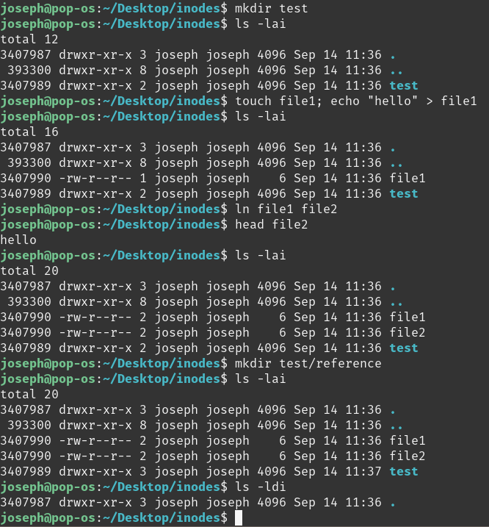
Created test, which has 2 links
created file1 with “hello” inside
Currently has 1 link, which is just itself
Created hardlink file2, which points to file1’s inode
When we view file2 contents, it’s the same as file1
When we view the inode/hardlink info with ls -lai
file1 and file2 have the same inode number: 3407990
3407990 has 2 links to it: file1 and file2
When we create test/reference, test’s hardlink count raises by 1 because reference contains the entry .., which links to test’s inode

Slide 44
Implications of hardlinks
Ex: file1 and file2 were linked to the same inode
When you change file1, file2 changes as well
And vice versa
When you remove file1, the original, we still have file2 remaining and we can still view the file contents
cp in linux creates a whole NEW file, with a different inode and just copies over the content from the original

Slide 45
Security implications of hardlinks
Common issue: unauthorized file
But if that unauthorized file had a hardlink to it, then the content remains on the system, just in a different location

Slide 46
Symlinks
Similar to hardlinks in that it will refer to an already existing file
But VERY different implementation
Does NOT have the same inode
It’s just a pointer that redirects to a different file path

Slide 47
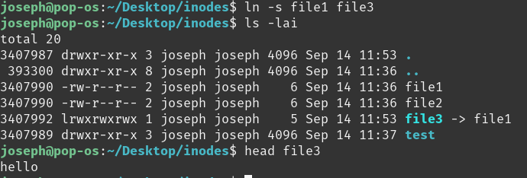
Example
-s means symbolic link
file3 -> file1
Arrow indicates symlink
file1 has inode 3407990
file3 has inode 3407992
When you view file3, it redirects you to file1, and therefore you see the file1 contents

Slide 48
Implications of symlinks
file3 is symlinked to file1
When you modify file1 or file3, you are modifying the SAME content
When you remove file3, file1 remains and you can use it normally
BUT when you remove file1, file3 still tries to redirect you to file1
Dangling symlink

Slide 49
Security implications of symlinks
If you find a backdoor’s SYMLINK and you remove it, then the backdoor remains on your system
Find where the ACTUAL location is with ls -l and look for where the symlink points to

Slide 50
Thanks!
Any questions?

